Slide 1
Deconstructing Whiteness in Archives
Society of Indiana Archivists
19 October 2018
10:30am-4:30pm
Sam Winn (@sam_winn)

Slide 2
Session Description
This workshop is designed for archives professionals who want to critically and constructively examine how dynamics of whiteness affect their work. Participants will reflect upon critical conversations in the archival profession, including #ArchivesSoWhite, M. Ramirez’s 2015 article “Being Assumed Not to Be: A Critique of Whiteness as an Archival Imperative,” and outcomes of the 2017 Liberatory Archives Forum in Portland, OR. Following an introduction to key concepts and definitions, trained facilitators will lead attendees in a series of participatory dialogues and exercises designed to unify theory and practice.

Slide 3
About Me
Samantha “Sam” Winn
Assistant professor, archivist, and senior diversity/inclusion representative for the University Libraries at Virginia Tech
Trained facilitator and instructor
Studies ethics of archival access and representation
What brought me to this work?
Notes:
Realizing that our field has little preparation or training on cultural competency; so we are not fully equipped to do our jobs in a way that respects and meets the needs of all the different communities to whom we are responsible. It creates opportunities for our profession to perpetuate systemic harms against marginalized and minoritized communities and it places significant functional and emotional burdens on our colleagues from those communities. Not only do we lack the training, but in many cases we lack the vocabulary to name the patterns and systems of harm. And as Kimberle Crenshaw tells us, if we can’t name a problem we can’t see it. And if we can’t see it we can’t address it. And that’s the broad overview of this workshop - first, were going to name the problem and identify some shared concepts and terms. Then we’re going to talk about where we have seen or contributed to the problem. And then we’ll start sharing some strategies for addressing it. Now, this is designed as a rather introductory class - and from the pre-session survey I understand that this is the first time many of you have attended a workshop like this. This workshop came out of a pilot session at SAA 2016 in Atlanta, where over 100 archivists gathered to discuss some of these same readings and participate in similar exercises.

Slide 4
Acknowledgments
Cecily Walker, Jennifer Vinopal, Jarrett Drake, Bergis Jules, Elvia Arroyo-Ramirez, Mario H. Ramirez, Dominique Luster, Michelle Caswell, Stacie Williams, Shanee' Yvette Murrain, Fobazi Ettarh, T-Kay Sangwand, Natalie Baur, Kimberly Christen, Itza Carbajal, April Hathcock, Emily Drabinski, Netanel Ganin, Chris Bourg, Angela Galvan, Craig Arthur, Tamar Evangelestia-Dougherty, Ricardo Punzalan, nina de jesus, Mark Matienzo, Eira Tansey, Verne Harris, Rand Jimerson Building on the work of Jennifer Vinopal and Cecily Walker, this list reflects some of the folks who have inspired and shaped my thinking on this topic.

Slide 5
Agenda
10:30-12:30 Deconstructing Whiteness Workshop with Samantha Winn, session 1 Introductions, review of key concepts from critical race theory, and community narrative exercises
12:30-1:45 Lunch on your own A list of nearby restaurants is provided
1:45-3:00 Workshop, session 2 Facilitated discussion of pre-readings (see tentative list below)
3:00-3:30 Break with light snacks
3:30-4:30 Workshop, session 3 Discussion of anti-oppression frameworks and their applications in archival practice

Slide 6
Ground Rules
Recognize your communication style (verbal/nonverbal). Expect to learn something about yourself and others. Speak from your own experience instead of generalizing. Participate honestly, openly, and to the fullest of your ability. Engage in the process by actively listening as well as speaking. Confidentiality, Curiosity & Charity. Take responsibility for yourself and what you say.

Slide 7
Additional tips
The goal is not necessarily to agree with each other, but to gain deeper insights.
If you tend to be quiet in group settings, challenge yourself to share more.
If you tend to speak up, challenge yourself to listen more.

Slide 8
Getting to know each other
“Who else…”
Share something true about yourself and invite others to raise a hand if it’s also true for them
What brought you to this workshop?
Reflect on/write down your answer (2 min)
Partner with someone to share your thoughts (3 min)
With you partner, find another pair and share (5 min)

Slide 9
Part One: Naming Whiteness
What do we mean by “whiteness”?
Not about the state of having light skin or a specific ethnic background
White normativity or hegemony
Angela Galvin and April Hathcock use whiteness as a signifier for “oppressive normativity”
Why do we use whiteness as a framework?

Slide 10
What is….. White supremacy?
Formal definitions
Eduardo Bonilla-Silva, Racism without Racists (2006)
“Whereas for most whites racism is prejudice, for most people of color racism is systemic or institutionalized.”
White supremacy is a “racialized social system” that “awarded systemic privileges to Europeans (the people who became ‘white’) over non-Europeans (the people who became ‘nonwhite’)...”
UCLA School of Public Affairs, Critical Race Theory
“...racism is ingrained in the fabric and system of the American society. The individual racist need not exist to note that institutional racism is pervasive in the dominant culture… these power structures are based on white privilege and white supremacy, which perpetuates the marginalization of people of color.”

Slide 11
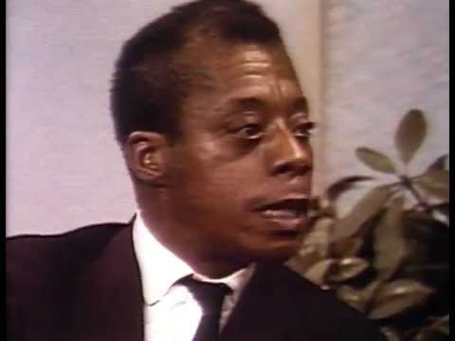
What is….. White supremacy?
James Baldwin

Slide 12
What is….. White privilege?
Formal definitions
Peggy McIntosh, Unpacking the Invisible Knapsack (1989)
“As a white person, I realized I had been taught about racism as something that puts others at a disadvantage, but had been taught not to see one of its corollary aspects, white privilege, which puts me at an advantage… I have come to see white privilege as an invisible package of unearned assets that I can count on cashing in each day, but about which I was “meant” to remain oblivious. White privilege is like an invisible weightless knapsack of special provisions, maps, passports, codebooks, visas, clothes, tools and blank checks.”

Slide 13
What is….. White privilege?
Formal definitions
Southern Poverty Law Center, Teaching Tolerance
“White skin privilege is not something that white people necessarily do, create or enjoy on purpose. Unlike the more overt individual and institutional manifestations of racism described above, white skin privilege is a transparent preference for whiteness that saturates our society. White skin privilege serves several functions. First, it provides white people with “perks” that we do not earn and that people of color do not enjoy. Second, it creates real advantages for us. White people are immune to a lot of challenges. Finally, white privilege shapes the world in which we live — the way that we navigate and interact with one another and with the world.”

Slide 14
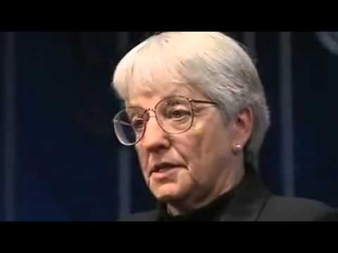
What is….. White privilege?
Jane Elliot

Slide 15
Corollary Concept...
White Fragility
Formal definitions
Robin DiAngelo, White Fragility (2011)
“White Fragility is a state in which even a minimum amount of racial stress becomes intolerable, triggering a range of defensive moves. These moves include the outward display of emotions such as anger, fear, and guilt, and behaviors such as argumentation, silence, and leaving the stress-inducing situation. These behaviors, in turn, function to reinstate white racial equilibrium.”

Slide 16
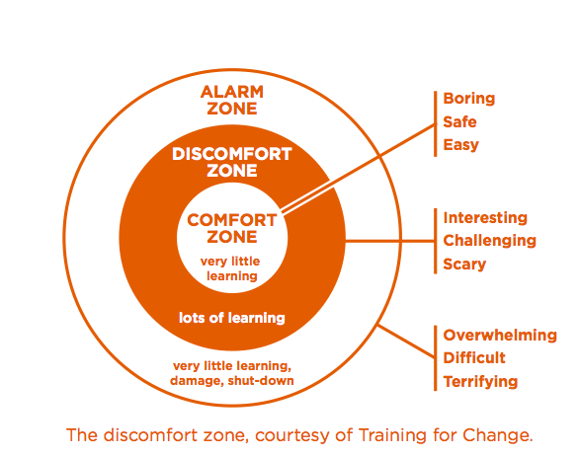
Corollary Concept...
White Fragility

Slide 17
What is….. Intersectionality?
Formal definitions
Cherríe Morega, La Guera (1979)
Interlocking oppressions. “I have observed that the usual response among white women's groups when the ‘racism issue’ comes up is to deny the difference… there is seldom any analysis of how the very nature and structure of the group itself may be founded on racist or classist assumptions.”
“I have come to believe that the only reason women of a privileged class will dare to look at how it is that they oppress, is when they've come to know the meaning of their own oppression.”
Patricia Hill Collins, Black Feminist Thought: Knowledge, Consciousness, and the Politics of Empowerment (1990)
Matrix of Domination. Recognizing that race, class, gender, sexual orientation, religion, ethnicity, age, etc as “interlocking systems of oppression.”
“Depending on the context, an individual may be an oppressor, a member of an oppressed group, or simultaneously oppressor and oppressed.”

Slide 18
What is….. Intersectionality?
Formal definitions
Kimberlé Crenshaw, Race, Gender, and Sexual Harassment (1992)
Intersectionality, the idea that each of us represents multiple identities - race, gender, sexual orientation, religious affiliation, national origin, class, ability, etc. These overlap or intersect in complex ways that cannot be understood by analyzing only one dimension of identity.
Moya Bailey, They aren’t talking about me (2010)
Misogynoir, the specific way racism and misogyny combine to oppress black women.

Slide 19
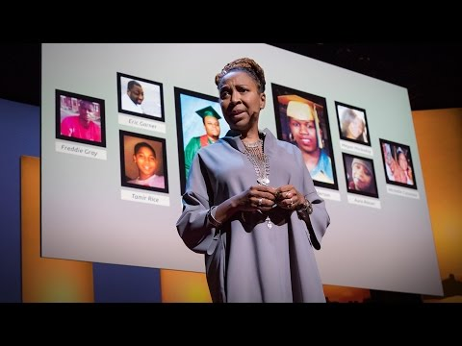
What is….. Intersectionality?
Kimberlé Crenshaw

Slide 20
Narrative Exercise: Naming Our Experiences
How often do you talk about race in your courses, workplace, or professional community?
How comfortable do you feel talking about race/racism in a professional context?
What holds you back?

Slide 21
Ground Rules Refresher
Recognize your communication style (verbal/nonverbal). Expect to learn something about yourself and others. Speak from your own experience instead of generalizing. Participate honestly, openly, and to the fullest of your ability. Engage in the process by actively listening as well as speaking. Confidentiality, Curiosity & Charity. Take responsibility for yourself and what you say.

Slide 22
Think | Pair | Share
Consider a time when you saw your community represented in a cultural narrative:
A movie/tv show, literature, a history lesson
Who was telling the story?
How did it feel to hear your story told in that way?
How often do you see yourself represented (accurately or inaccurately) in cultural narratives?
Notes:
5 minutes think, 7 minutes pair, 18 minutes share? 30 minutes to discuss as a group - feelings check in.

Slide 23
Part Two: Seeing Whiteness at Work
Divide into groups of three.
Around the room, you will find eight stations.
Each group will spend five minutes per station, reading the prompt and discussing the answers.
After every group has visited every station, we’ll gather as a full group to discuss the prompts.

Slide 24
Station 1: Arroyo-Ramirez, “Invisible Defaults”
Bourg makes the sobering point that “without active intervention we end up… classifying and arranging our content in ways that further marginalizes works by and about people of color, queer people, indigenous peoples, and others who don’t fit neatly into a classification system that sets the default as western, white, straight, and male.”
… I argue that it takes critical awareness, consciousness, and ethical responsibility to uphold the cultural and political integrity of archival collections that are located outside of the (in)visible default of “western, white, straight, and male” — and, I add here, collections written in languages that are not English.
What invisible defaults exist in your institution’s approach to appraisal, arrangement, and description?

Slide 25
Station 2: Arroyo-Ramirez, “Invisible Defaults”
As archivists we have the responsibility to “do no harm” ... to the collections we are trusted to manage and keep safe. But often in our archival processes, especially in the newer frontier of born-digital processing, we must juggle many constraints and responsibilities (i.e. time, resources, knowledge, expertise) that force us to make exceptions and workarounds to this “no harm” principle…. which exceptions are we willing to make or which processes are we willing to work through (as opposed to work around), based on the perceived value or implications of the issue at hand?
In this article, Elvia Arroyo-Ramirez presented a case study in which “best-practices” for born-digital archives jeopardized the linguistic integrity of the creator’s file structure. How have you handled situations in which the needs of a collection conflict with professional standards?

Slide 26
Station 3: Jules, “Confronting Our Failure of Care”
The politics of what we’ve traditionally preserved means the archive is filled with silences, absences, and distortions, mostly affecting the legacies of the less privileged, including black women, LGBTQ people, immigrants, poor people, and victims of police violence, to name a few. In the name of neutrality, we’re erasing people, communities and their humanity from the historical record.
Whose legacy is missing from the collections you manage or use?

Slide 27
Station 4: Jules, “Confronting Our Failure of Care”
We have to ask ourselves, what do we owe [these historically marginalized communities] as fellow humans, as archivists, as culture keepers, and as the people who’ve charged ourselves with deciding who gets remembered and who doesn’t? What do we owe communities that are constantly victimized because of erasure and by erasure?
As individuals and as a profession, what do we owe communities whose stories have been marginalized, distorted, erased, or commodified by cultural heritage organizations?

Slide 28
Station 5: Ramirez, “Being Assumed Not to Be”
Well intended as most archivists are, the very fact that the profession is predominantly white limits the possibility of having a dialogue about racial diversity, for example, due to the fact that the engine of homogeneity driving the profession is not perceived as a problem. As V. Chapman-Smith has pointed out, although population trends indicate that by 2050 the United States will be a majority minority nation, the pipeline currently feeding the archival profession, and its future leadership, stems from fields among “the whitest in the United States.” ... Given the aforementioned demographic shifts, archivists will be hard pressed to claim relevance for the majority of people living in the United States and will be woefully out of step with the historical future.
Ramirez cited a 2012 SAA membership survey, which found that 89% of respondents identified as white. What does this look like in your own institution? In your professional associations? In your library school?

Slide 29
Station 6: Ramirez, “Being Assumed Not to Be”
Moreover, [Mark Greene] is keen on making a distinction between a commitment to “diversity” and the diversification of archival holdings, and what he posits as the social justice demand that archivists engage in attempting to change structural inequalities typically negotiated in the realm of politics…. he continuously maintains that archivists’ only responsibility to this concept is in gathering collections that reflect individuals and organizations of varied backgrounds.
Where do you envision the key work of diversity and inclusion in archives? Why?

Slide 30
Station 7: Robinson-Sweet, “Truth and Reconciliation”
Gudmund Valderhaug, in his article on the reparations, explained how the archives found itself implicated in this history of state-sponsored discrimination: “The records in question were created by the very same public bodies that discriminated against the war children and neglected their needs, and they created the records to justify exactly the same actions. Consequently, the war children’s own voices are not present in the Norwegian archival heritage.” The Norwegian archivists would have to confront their history as a tool of the state to provide justice to victims.
As Valderhaug explained, when archivists are faced with a situation such as this one, they can simply handle the request of the victim as they would any other reference question, but they are obligated by their “position of power in relation to the user” to go further.
Do you agree with Valderhaug’s assertion of responsibility? Why or why not?

Slide 31
Station 8: Robinson-Sweet, “Truth and Reconciliation”
Tonia Sutherland scathingly indicted archives’ continued failure to collect materials documenting violence against black Americans, a failure she says amounts to “archival amnesty.” Sutherland said that despite the large quantity of images showing “Black death” at the hands of whites, archives have declined to collect these materials. Here “Black death” refers to the lynchings and riots of the twentieth century as well as to police killings like those on the Danziger Bridge. By not bringing these materials into their collections, archives are obstructing the ability to hold perpetrators and the system of racist violence accountable: “American archives, through appraisal and other practices, continue to extend the amnesty that was granted to Confederate slavers by inadequately collecting and maintaining the records that would make transitional and restorative justice possible in the U.S.”
How do your accession policies inform which stories are represented in the archives? What unspoken assumptions determine what gets collected? Do you see similar gaps in your own materials?

Slide 32
Part Three: Challenging Oppressive Normativity
Wicked Question: “How is it that we are ___ and we are ___ simultaneously?” (Both blanks should be positive)
5 min to write down paradoxes on your own.
5 min to share in groups of 3-4; pick your favorite.
5 min for each group to share its favorite with the full group.
5 minutes to sort into new groups by question.
Notes:
“What opposing-yet-complementary strategies do we need to pursue simultaneously in order to be successful?”

Slide 33
Part Three: Challenging Oppressive Normativity
15% Solutions: In response to the Wicked Question you identified last round, “Where do you have discretion and freedom to act? What can you do without more resources or authority?”
2 min to generate your own list
8 min for everyone in the group to share their list
10 min to ask clarifying questions and share advice within the group
Notes:
“What opposing-yet-complementary strategies do we need to pursue simultaneously in order to be successful?”

Slide 34
Full group debrief
Report out
One thing I learned today is…
One thing I want to study further is…
One thing I hope to try this year is...
Please send feedback!
What worked well for you?
What should we do differently next time?

Slide 35
Deconstructing Whiteness in Archives
Society of Indiana Archivists
19 October 2018
10:30am-4:30pm
Sam Winn (@sam_winn)
samw@vt.edu

